Slide 1
Neighborhood Operations
Take a pixel and do some aggregation function of that pixel and its neighbors eg in convolutional neural networks.
Eh in photos where we want to focus on the center and blur out some parts, average the image and neighbors together so it is more difficult to see the difference between them.
Adding color is a level operation, but things like blur, edge detection, adding noise etc are neighborhood operations.
Soln1 lab2 sep 1st 1:28pm
CSCI 4150/6050: Computer Vision
Slides Credit: Dr. Bryan Morse from BYU

Slide 2
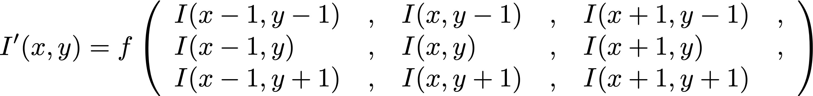
Neighborhood Operations
Output pixel value is a function of that pixel and its neighbors
Possible operations: sum, weighted sum, average, weighted average, min, max, median, …
Most common workhorse in image processing

Slide 3

The Pixel Grid
Many of the things we do involve using “neighboring” pixels
Common approaches:
  4-connected (N, S, E, W)
  8-connected (add NE, SE, SW, NW)
Distance?
  Euclidean (as the crow flies)
  4-connected (“city block”, “Manhattan”)
  8-connected (“chessboard”)

Slide 4
Spatial Filtering
Most common is to multiply each of the pixels in the neighborhood by a respective weight and add them together
The local weights are called a mask or kernel
I(x-1,y-1) | I(x,y-1) | I(x+1,y-1)
I(x-1,y) | I(x,y) | I(x+1,y)
I(x-1,y+1) | I(x,y+1) | I(x+1,y+1)
w(-1,-1) | w(0,-1) | w(1,-1)
w(-1,0) | w(0,0) | w(1,0)
w(-1,1) | w(0,1) | w(1,1)
Kernel is the set of weights we use to multiply the pixels.

Slide 5
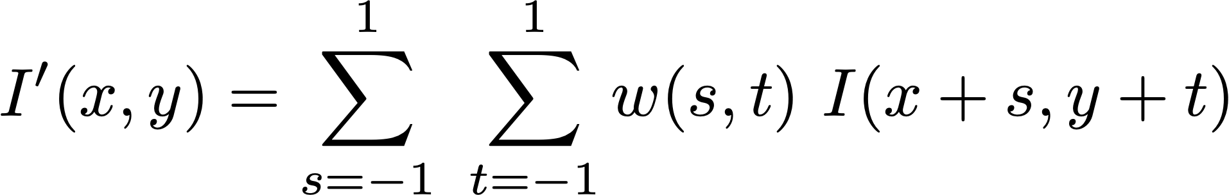
Spatial Filtering
I(x-1,y-1) | I(x,y-1) | I(x+1,y-1)
I(x-1,y) | I(x,y) | I(x+1,y)
I(x-1,y+1) | I(x,y+1) | I(x+1,y+1)
w(-1,-1) | w(0,-1) | w(1,-1)
w(-1,0) | w(0,0) | w(1,0)
w(-1,1) | w(0,1) | w(1,1)

Slide 6
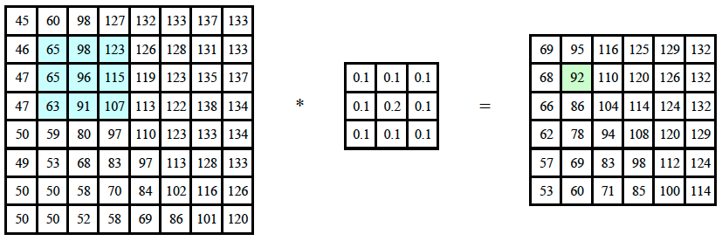

Spatial Filtering
Pairwise multiplication, ie 65*0.1+98*0.1+….+96*0.2+...+107*0.1=92
Also the sum of the kernel here is =1
Note that the size of the image changed here as well due to no padding
notation for convolution operator
Numpy implementation for the 96 pixel:
im[i,j]=im[i-1:i+2,j-1:j+2] * kernel
Note that to increase the size of the kernel just do i+ a bigger slice number, etc
Implementing this without using for loops, we break down the image and offset it…, apply the kernel and then recombine them dimensionally.

Slide 7
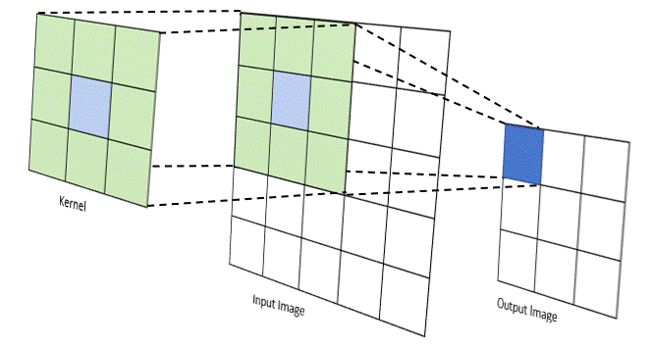
Spatial Filtering

Slide 8
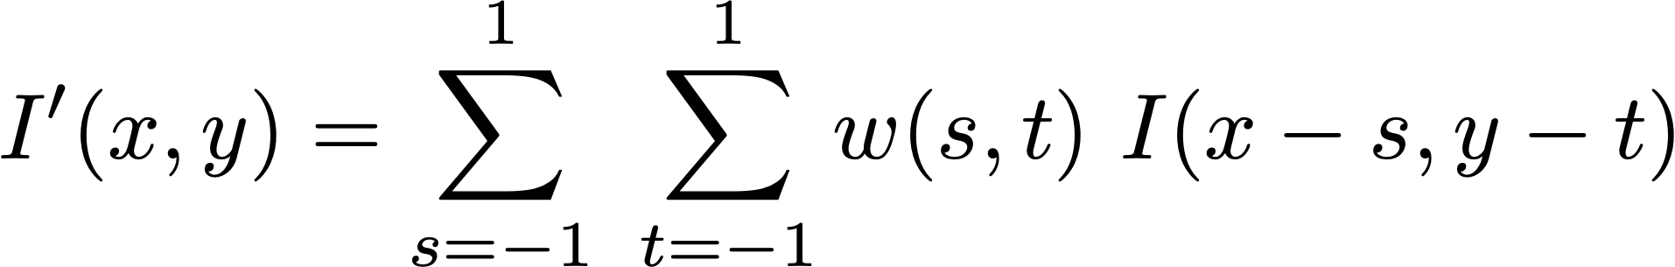
Convolution
Most times the convolution filters are symmetric so it doesn’t matter it acts same as spacial filtering
Else here multiply I(x-1, y-1) * w(-1, -1) instead of w(1, 1) as in spacial filtering.
I(x-1,y-1) | I(x,y-1) | I(x+1,y-1)
I(x-1,y) | I(x,y) | I(x+1,y)
I(x-1,y+1) | I(x,y+1) | I(x+1,y+1)
w(1,1) | w(0,1) | w(-1,1)
w(1,0) | w(0,0) | w(-1,0)
w(1,-1) | w(0,-1) | w(-1,-1)
Convolution is the same thing with the mask flipped

Slide 9
Correlation vs. Convolution
Technically, spatial filtering is correlation, different from convolution
They are the same up to flipping the mask/kernel
Many casually use them interchangeably
(be careful with the details)
w(-1,-1) | w(0,-1) | w(1,-1)
w(-1,0) | w(0,0) | w(1,0)
w(-1,1) | w(0,1) | w(1,1)
w(1,1) | w(0,1) | w(-1,1)
w(1,0) | w(0,0) | w(-1,0)
w(1,-1) | w(0,-1) | w(-1,-1)

Slide 10
Padding
For lab2 its optional but good to use one of these methods to implement padding
What do you do outside the image boundaries?
  Assume zero (tends to darken borders if blurring)
  Assume other constant value (perhaps average of entire image)
  Wrap around
  Assume same as closest pixel still in image
  Or just don’t go there
Zero tends to darken the borders, so the constant
Is much better, eg using the average of the pixels on the boundary

Slide 11
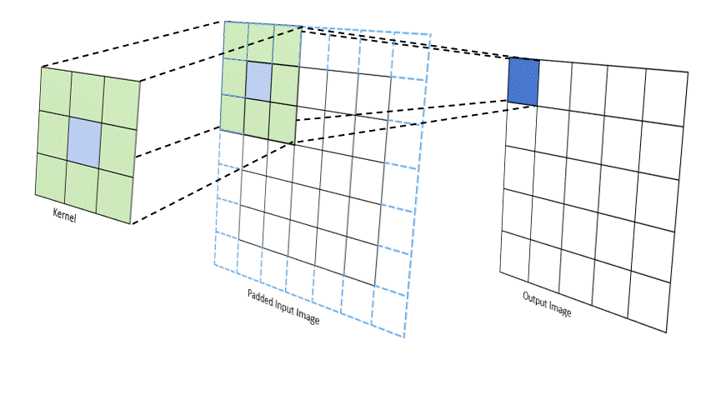
Padded Convolution

Slide 12

Convolution
Applications:
  Blurring
  Sharpening
  Edge detection
  and many more…

Slide 13
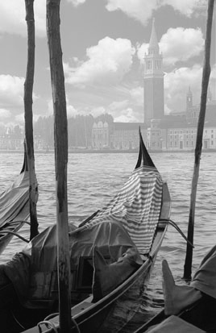

Smoothing
If we can average multiple images together to remove noise, why not average multiple pixels?
What does this assume?
Effects:
  Reduces noise
  Causes blurring

Slide 14
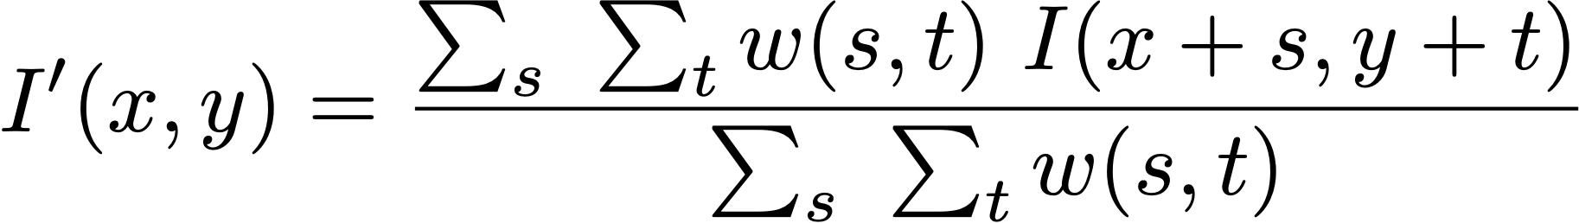
Smoothing
Any kernel with all positive weights does smoothing / blurring
To average rather than add,
divide by the sum of the weights
Can be any size
(larger means more blurring)
1 | 1 | 1
1 | 1 | 1
1 | 1 | 1
1 | 1 | 1
1 | 2 | 1
1 | 1 | 1
1 | 2 | 1
2 | 4 | 2
1 | 2 | 1
1 | 1 | 1 | 1 | 1
1 | 1 | 1 | 1 | 1
1 | 1 | 1 | 1 | 1
1 | 1 | 1 | 1 | 1
1 | 1 | 1 | 1 | 1
Ie do the convolution and divide by the sum of weights eg divide by 9 for the firs kernel on
The left. This helps keep the value between 0 and 255.
If done multiple times, the image becomes the average of the pixel values, just a grayscale look

Slide 15
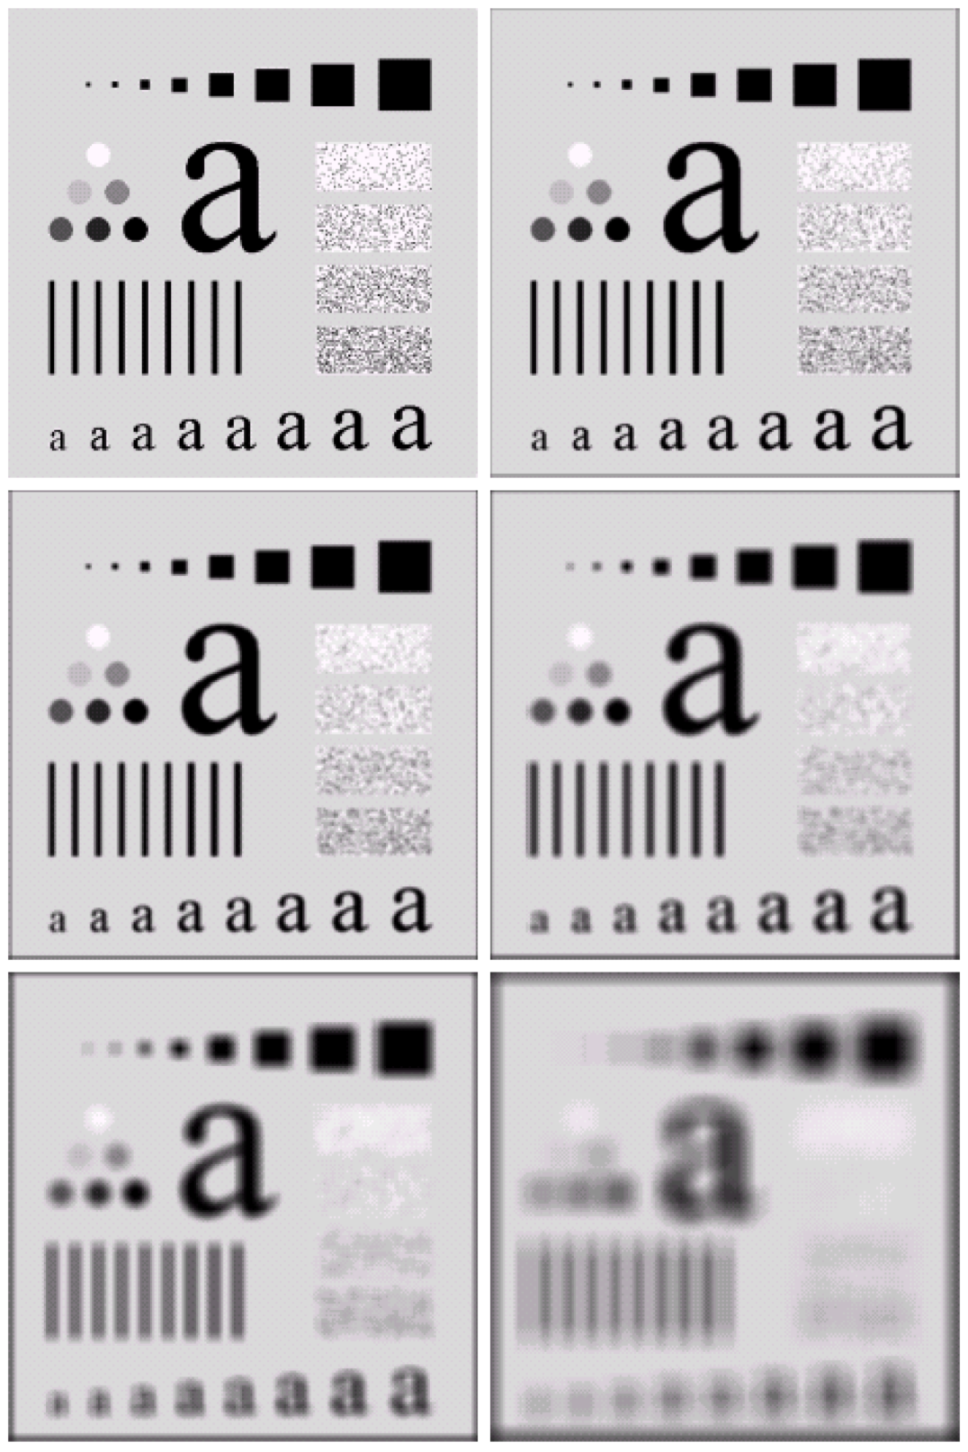
Smoothing

Slide 16
Nonlinear Smoothing
With linear smoothing, we are applying the filter to the entire image in the same way, so you’re removing noise but also it gets blur.
This nonlinear smoothing tries a different approach by applying the filter … so we can remove noise but not blur it a lot.
Spatial filtering is linear, but many neighborhood operators are not
Some do noise reduction:
  Trimmed mean – ie account for outliers
  Median filter
  Bilateral filtering (or other adaptive weights)
These try to be less sensitive to outliers and/or respect edges

Slide 17
Median Filtering
Ie median here, arrange values in ascending or descending order to get the median. This helps with outliers as it is not as affected as medians
Output is the median (not the mean) of the neighborhood pixels
  More robust to outliers
  (great for “salt and pepper” noise)
  Tries to respect edges
  (goes with local majority)
  But often rounds corners or
  loses very small/thin things

Slide 18
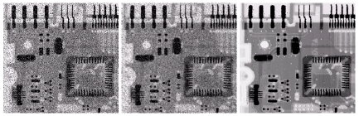
Median Filtering
Median preserves the edges better and blurs the noise. Best in this case
Original
Mean
Median

Slide 19
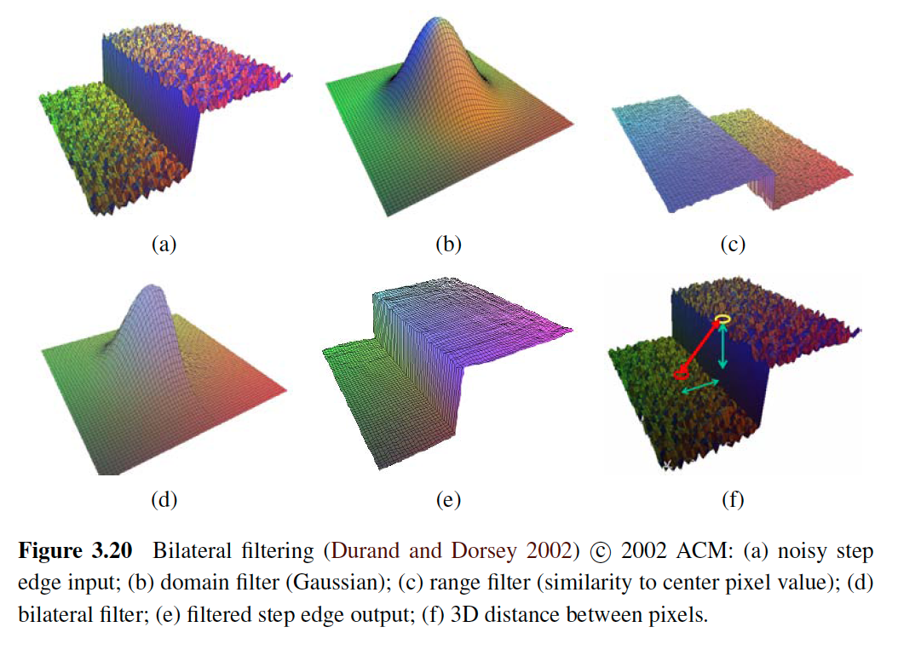
Bilateral Filtering
Spatially adapt the weights of the mask
  Closer neighbors get more weight
  Similar neighbors get more weight
Many similar approaches use this idea, but this is most popular now
Computationally expensive, but there are efficient approximations

Slide 20
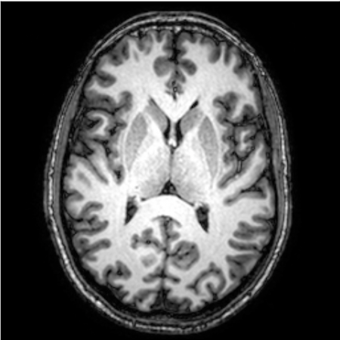
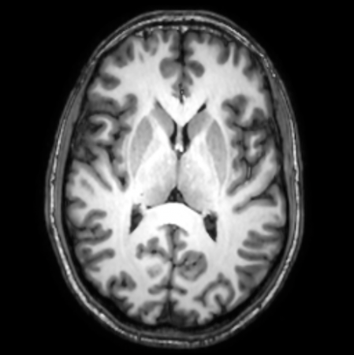
Anisotropic Diffusion
Iteratively diffuse (blur) based on neighbor similarity

Slide 21
Let’s try convolution in NumPy…
im[i,j]=im[i-1:i+2,j-1:j+2] * kernel

Slide 22
Coming up...
More neighborhood operations:
    sharpening
    edge detection

Slide 23
Bilateral Filtering

